Slide 1
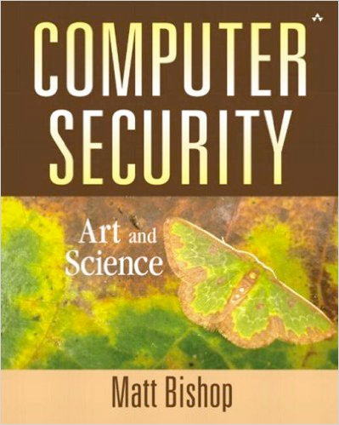
Computer and Network Security COMP 5370/637* Lecture #3 August 21, 2015
Tony Skjellum
skjellum@auburn.edu

Slide 2
Today’s Topics
More Basics - Models

Slide 3
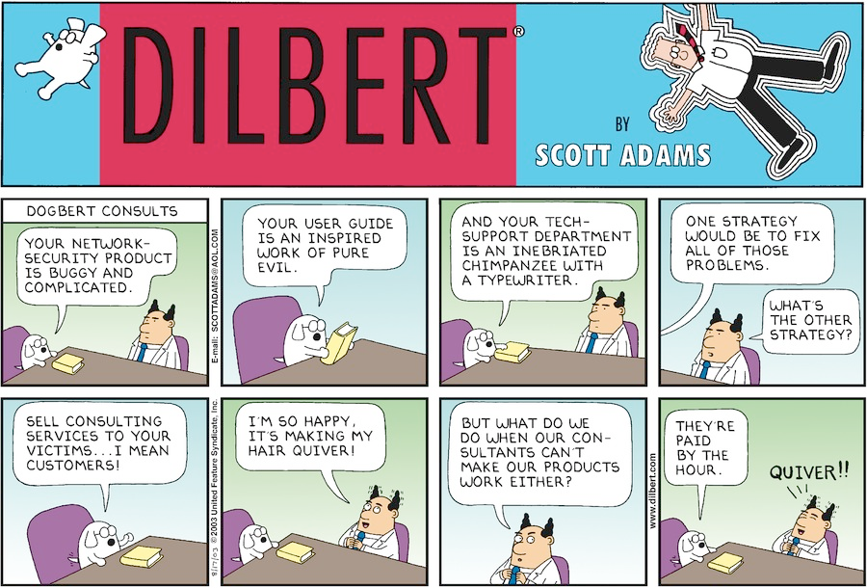
What is Network Security? (Not)
Opinions?
http://dilbert.com/search_results?terms=network+security

Slide 4
To Do’s from Last Time
Read Auburn’s security policy (there are many)
http://www.auburn.edu/oit/it_policies/
http://www.auburn.edu/oit/it_policies/data_security_policy.php
Come prepared to discuss AU's security mechanisms.
Learn about password vaults – adopt one
Learn about GPG/PGP, make your pub/private key pair
Make one
Keep the secret key a secret!
Use a strong password to protect access to it!
Add your key to your mail software if supported
Cf, https://www.gnupg.org/

Slide 5
Protection System
Describes conditions under which a system is secure
Access control matrix
Classical (and simple) abstraction mechanism for representing secure states
Consists of a matrix describing security rights of subjects
And a set of allowable transitions that alter those rights

Slide 6
Access Control Matrix Concept
Subjects S = { s₁,…,s_{n} }
Objects O = { o₁,…,o_{m} }
Rights R = { r₁,…,r_{k} }
Entries A[s_{i}, o_{j}] ⊆ R
A[s_{i}, o_{j}] = { r_{x}, …, r_{y} } means subject s_{i} has rights r_{x}, …, r_{y} over object o_{j}
objects (entities)
o₁ … o_{m} s₁ … s_{n}
s₁
s₂
…
s_{n}
subjects

Slide 7
Example 1
Processes p, q
Files f, g
Rights r, w, x, a, o
r - read, w- write, x- execute, a- append, o- modify
f g p q
p rwo r rwxo w
q a ro r rwxo

Slide 8
Example 2
Procedures inc_ctr, dec_ctr, manage
Variable counter
Rights +, –, call
counter inc_ctr dec_ctr manage
inc_ctr +
dec_ctr –
manage call call call

Slide 9
State Transitions
Change the protection state of system
|– represents transition
X_{i} |– _{τ} X_{i+1}: command τ moves system from state X_{i} to X_{i+1}
X_{i} |– * X_{i+1}: a sequence of commands moves system from state X_{i} to X_{i+1}
Commands often called transformation procedures
we want to ensure no transformation takes the system into an insecure state

Slide 10
Primitive Operations
create subject s create object o
Creates new row, column in ACM creates new column in ACM
destroy subject s destroy object o
Deletes row, column from ACM deletes column from ACM
enter r into A[s, o]
Adds r rights for subject s over object o
delete r from A[s, o]
Removes r rights from subject s over object o

Slide 11
Creating File
Security process p creates file f with r and w permission.
command create•file(p, f)
create object f;
enter own into A[p, f];
enter r into A[p, f];
enter w into A[p, f];
end
command grant•read•file•1(p, f, q)
if own in A[p, f] then
enter r into A[q, f];
end
Q: What does it mean if a process aborts before completing?

Slide 12
Protection Rights
Let R be a set of security rights. When a right r is added to an access control matrix not already containing r, r is said to be leaked.
If a system S, beginning in initial state s₀, cannot leak right r, it is safe with respect to the right r.
Does there exist an algorithm for determining whether a protection system S with initial state s₀ is safe with respect to a generic right r?
yes, in limited cases
undecidable in the general sense
Q: Covert channels?

Slide 13
Security Policy
Policy partitions system states into:
Authorized (secure)
These are states the system can enter
Unauthorized (non-secure)
If the system enters any of these states, it is a security violation
Secure system
Starts in authorized state
Never enters unauthorized state

Slide 14
Basics … again
Confidentiality
X set of entities, I information
I has confidentiality property with respect to X if no x ∈ X can obtain information from I

Slide 15
Basics … again
Integrity
X set of entities, I information
I has integrity property with respect to X if all x ∈ X trusts information in I
Types of integrity:
data integrity: trust I and its conveyance
origin integrity: trust source of I
assurance: I functions as it should

Slide 16
Basics … again
Availability
X set of entities, I resource
I has availability property with respect to X if all x ∈ X can access I
Types of availability:
Bi-conditional availability: x can/can not access I
Qualitative availability: the speed/latency/condition x accesses I

Slide 17
Types of Security Policies
Military (governmental) security policy
Policy primarily protecting confidentiality
Commercial security policy
Policy primarily protecting integrity
Confidentiality policy
Policy protecting only confidentiality
Integrity policy
Policy protecting only integrity

Slide 18
Transformations … again
Discretionary Access Control (DAC)
individual user sets access control mechanism to allow or deny access to an object
Mandatory Access Control (MAC)
system mechanism controls access to object, and individuals cannot alter that access
Originator Controlled Access Control (ORCON)
originator (creator) of information controls who can access information

Slide 19
Role-based access control
Information I accessible via RBAC
An entity is assigned a role
A set of roles are assigned a set of rights (authorized)
When a role is authenticated to to an entity, it gains those rights
Rights convey access to the piece of Information I if the assigned role gives permissions
An entity can have multiple roles (perhaps only one at a time)
RBAC can lead to conflicts; certain combinations should be disallowed (payment, audit payment, etc)

Slide 20
Mechanisms
Entity or procedure that enforces some part of the security policy
Access controls (like bits to prevent someone from reading a homework file)
Disallowing people from bringing CDs and floppy disks into a computer facility to control what is placed on systems

Slide 21
Policies vs Mechanisms
Policies describe what is allowed
Mechanisms control how policies are enforced
Trust underlies everything

Slide 22
Confidentiality Policy
Goal: prevent the unauthorized disclosure of information
Focus on information flow
Classical approach: Bell-LaPadula Model

Slide 23
Bell-LaPadula Model – Simple
Security levels arranged in linear ordering
Top Secret
Secret
Unclassified
Objects have security classification L(o)
Subjects have security clearance L(s)
Ref: https://en.wikipedia.org/wiki/Bell%E2%80%93LaPadula_model

Slide 24
Example
security level | subject | object
Top Secret | Bob | Personnel Files
Secret | Samuel | E-Mail Files
Confidential | Susan | Activity Logs
Unclassified | Raymond | Telephone Lists
Bob can read all files
Susan cannot read Personnel or E-Mail Files
Raymond can only memorize Telephone Lists

Slide 25
Information Flow
Information flows in one direction only
“Reads up” disallowed, “reads down” allowed
Subject s can read object o iff L(o) ≤ L(s) and s has permission to read o
The Simple Security Property - no read up
“Writes up” allowed, “writes down” disallowed
Subject s can write object o iff L(s) ≤ L(o) and s has permission to write o
★-property – no write-down
Note the combination of mandatory control (relationship of security levels) and discretionary control (the required permission)
If a system is initially in a secure state, and every transition of the system satisfies these conditions and the ★-property, then every state of the system is secure

Slide 26
Bell-LaPadula Model -- Expanded
Expand notion of security level to include categories
Security level is (clearance, category set)
Examples
( Top Secret, { NUC, EUR, ASI } )
( Confidential, { EUR, ASI } )
( Secret, { NUC, ASI } )

Slide 27
Levels and Lattices
Domination
implements "comparable"
(A, C) dom (A′, C′) iff A′ ≤ A and C′ ⊆ C
Which Dominates?
(Top Secret, {NUC, ASI}) |  | (Secret, {NUC})
(Secret, {NUC, EUR}) |  | (Confidential,{NUC, EUR})
(Top Secret, {NUC}) |  | (Confidential, {EUR})

Slide 28
Information Flow … again
Information flows in one direction only
“Reads up” disallowed, “reads down” allowed
Subject s can read object o iff L(s) dom L(o) and s has permission to read o
“Writes up” allowed, “writes down” disallowed
Subject s can write object o iff L(o) dom L(s) and s has permission to write o
Note the combination of mandatory control (relationship of security levels) and discretionary control (the required permission)
If a system is initially in a secure state, and every transition of the system satisfies these conditions and the ★-property, then every state of the system is secure

Slide 29
Adjustments
(A, C) dom (A′, C′) iff A′ ≤ A and C′ ⊆ C
then (TS, {NUC}) ←dom (Confidential, {EUR})
and (TS, {NUC, EUR}) ←dom (TS, {EUR})
in general
A ≥ A' and C'⊂C prevents read down and write up
does this make sense, especially with:
(TS, {NUC, EUR}) ←dom (TS, {EUR})

Slide 30
Adjustments
(A, C) dom (A′, C′) iff A′ ≤ A and C′ ⊆ C
then (TS, {NUC}) ←dom (Confidential, {EUR})
and (TS, {NUC, EUR}) ←dom (TS, {EUR})
in general
A ≥ A' and C'⊂C prevents read down and write up
does this make sense, especially with:
(TS, {NUC, EUR}) ←dom (TS, {EUR})

Slide 31
Adjustments (con't)
Define maximum, current levels for subjects
allow subject to downgrade within level as long as
maxlevel dom curlevel
Example
Let
Bob have maxlevel(TS, {NUC, EUR})
Sue have maxlevel(TS, {EUR})
Bob sets curlevel to (TS, {EUR})
Now, L(Sue) dom L(Bob)
Bob can write to Sue without violating "no writes down"
but, Bob assumes responsibility for not leaking information to a different compartment
Traditional approach in military:
Linear model among levels levels
Lattice model within highest level

Slide 32
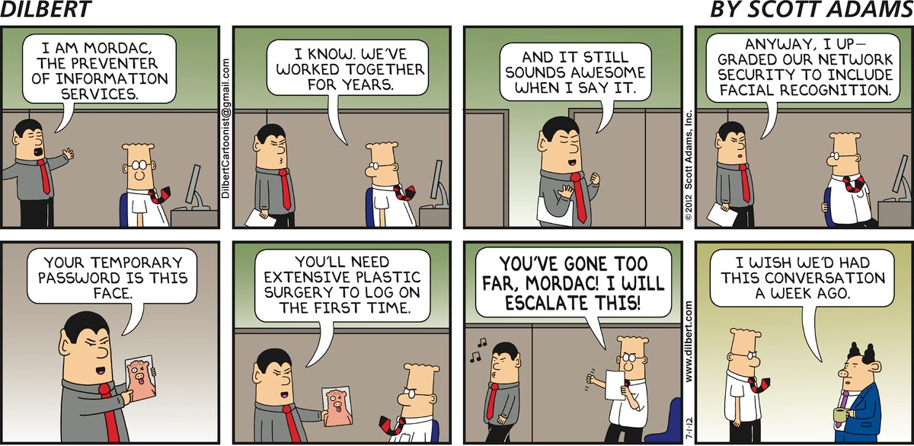
Dilbert’s take on Authentication…
http://dilbert.com/search_results?terms=network+security

Slide 33
To Do’s
Read Chapter 1 on Bishop

Slide 34
BACKUP

